Slide 1
FOCUS ON THE BASICS
Building Capacity
in
READING & MATHEMATICS

Slide 2
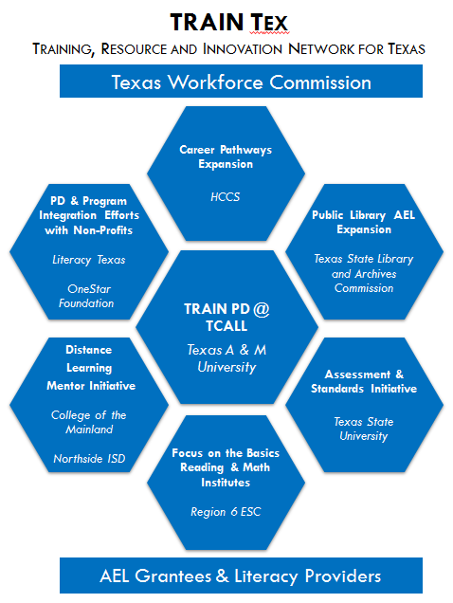
TRAIN TEX
Capacity Building Projects
Focus on the Basics (FOTB)
Helping Adults Read for Transitions (HART)
Adult Initiatives in Math (AIM)

Slide 3
1
Helping Adults
Read for Transitions
2

Slide 4
HART Contract
“Focus on the Basics” (FOB) is one of the capacity building initiatives for Texas.
It serves staff and/or volunteers of organizations that provide Adult Education and Literacy Services.

Slide 5
Goal
HART’s goal is to create training,
materials and content that promote reading success for all Adult Education clients.

Slide 6
Reading Task Group
HART established a reading task group made up of Subject Matter Experts. This group holds expertise in working with AEL, ELL, Dev Ed, struggling students…all students.

Slide 7
Content Writers
Content writers were chosen and the group delivered recommendations for:
New content
Research-based and best practices
Online Resources
Assessment tools
Alignment to the draft of content standards
Strategies for teachers

Slide 8
Challenges
Recruitment (Thank you TCALL)
The biggest challenges…
Scope of project
Need for reading training
Training requirements
Notes:
Time (one 2 day training isn’t enough)
All the new AEL teachers (so much information)
Preparing Trainers before they attend

Slide 9
HART Outcomes
30 trainers will take content to their local AEL provider and share with teachers to provide the highest level of knowledge and success.

Slide 10
1AIM
Program Director: Angeline Kaldro
akaldro@esc6.net

Slide 11
AIM Mission Statement
Build capacity
Apply research-based best practices
Align curriculum framework to content standards
Provide curriculum training
Mentoring AIM trainers & guiding teachers
Assess program effectiveness

Slide 12
AIM Task Group
College workforce director
ESC math specialists
Previous Math Institute members
Math Professor, School of Education
Math teacher mentors
Prison adult education teacher
ESC Coordinator, Curriculum & Instruction
Adult Education Component Director, Region 6 ESC
AIM Project Director
Accelerate Texas/ABE instructor
Math Developmental Education instructor
Intensive College Readiness math instructor
Notes:
Experience teaching math to students with special needs

Slide 13
Training of Trainers (TOT)
AIM cadre of trainers (28 participants)
Model curricula to local program teachers
Training and follow up for local program instructors

Slide 14
Challenges
Recruiting subject matter experts
Recruitng TOT participants
Widespread need
Notes:
Programs do not pay over that…math requirement , provides PD through expenditures within itself: if Not, back where we were. If you want competent teachers who in most cases not math fluent provide instruction which results in comprehension, gotta pay to get math modeling, practice, curricula targeted to the multi-faceted AEL classrooms.

Slide 15
First Four Curriculum Modules
Module 1: Graphs, charts and number lines
Module 2: Measurements and conversions
Module 3: Patterns and sequences
Module 4: Ratios, decimals and proportions
Notes:
After much discussion, the Task group decided after on the top four areas
Subarea II.9 --Financial Lieracy

Slide 16
NEXT Four Curriculum Modules
Module 5: College and career skills
Module 6: Income, expenses and consumers
Module 7: Interest, Capital formation & financial markets
Module 8: Budgeting and financial aid

Slide 17
AIM Outcomes
Build local capacity for math instruction
Trainers/mentors at local program level
Curriculum for classroom teachers
More student successes, including employability &
college readiness
Strengthen statewide capacity for resources, training and support
Notes:
According to FOB abstract of work

Slide 18
QUESTIONS

